Slide 1
Webinar Machine learning in practice
Bert Wassink
Joost Krapels
Stefan Leijnen
Sieuwert van Otterloo
July 17th, 2020

Slide 2


About the team
Dr. Stefan Leijnen , dr. Sieuwert van Otterloo
Utrecht University of Applied Sciences, Artificial Intelligence research group.
Applied research into responsible and ethical use of AI
Dr. Sieuwert van Otterloo, Joost Krapels MSc.
ICT Institute
Practical IT advice to large and medium-sized companies. Focus on software project management, security, privacy / personal data and AI.
Bert Wassink MSc.
Dataworkz – smart and fast data expert
Applied data science

Slide 3
Agenda
Explanation of machine learning and neural networks
Training a machine learning algorithm (Demonstration)
Practical and ethical consequences of using machine learning

Slide 4
How to train a network yourself
Install python (https://www.python.org/downloads/) and the Jupyter toolbox:
Download the data set and python notebook at https://github.com/swzaken/cars-neuralnetwork
Install python packages. You can use the following commands
Library | Description | Command to install
Updated version of Pip | Installing packages | python –m pip install –upgrade pip
Numpy | Arrays and numbers | pip install numpy
MatPlotLib | Data visualization | pip install matplotlib
Pillow | Image processing | pip install pillow
JuPyter Notebooks | Running the code | pip install jupyterlab
Tensorflow | Machine learning algorithms | pip install tensorflow
If you do multiple python projects, we recommend an environment manager, such as Conda.
https://www.anaconda.com/products/individual

Slide 5

What is Artificial Intelligence?
“The question of whether a computer can think is no more interesting than the question of whether a submarine can swim.”
Edsger W Dijkstra (computer scientist, 1930- 2002)
Artificial Intelligence is concerned with letting computers do tasks that humans would use intelligence for. There are many different artificial intelligence techniques, varying from rule based expert systems to biology-inspired methods.

Slide 6
Why is Artificial Intelligence popular?
Discovery of new algorithms that can ‘learn’ more tasks with less assistance from human experts
Digital innovation (e.g. search engines, e-commerce, smart meters, social media, digital camera’s) have made it much easier to collect and connects data sets
Improvements into parallel computing (driven by computer graphics chips) have made processing large data sets feasible

Slide 7
Neural networks is a subfield of AI
Artificial Intelligence
Data science
Knowledge modelling
Machine learning
Neural networks
Evolutionary algorithms
Statistics
Symbolic reasoning
Search
Linear regression
Modal
logics
Reinforcement learning

Slide 8
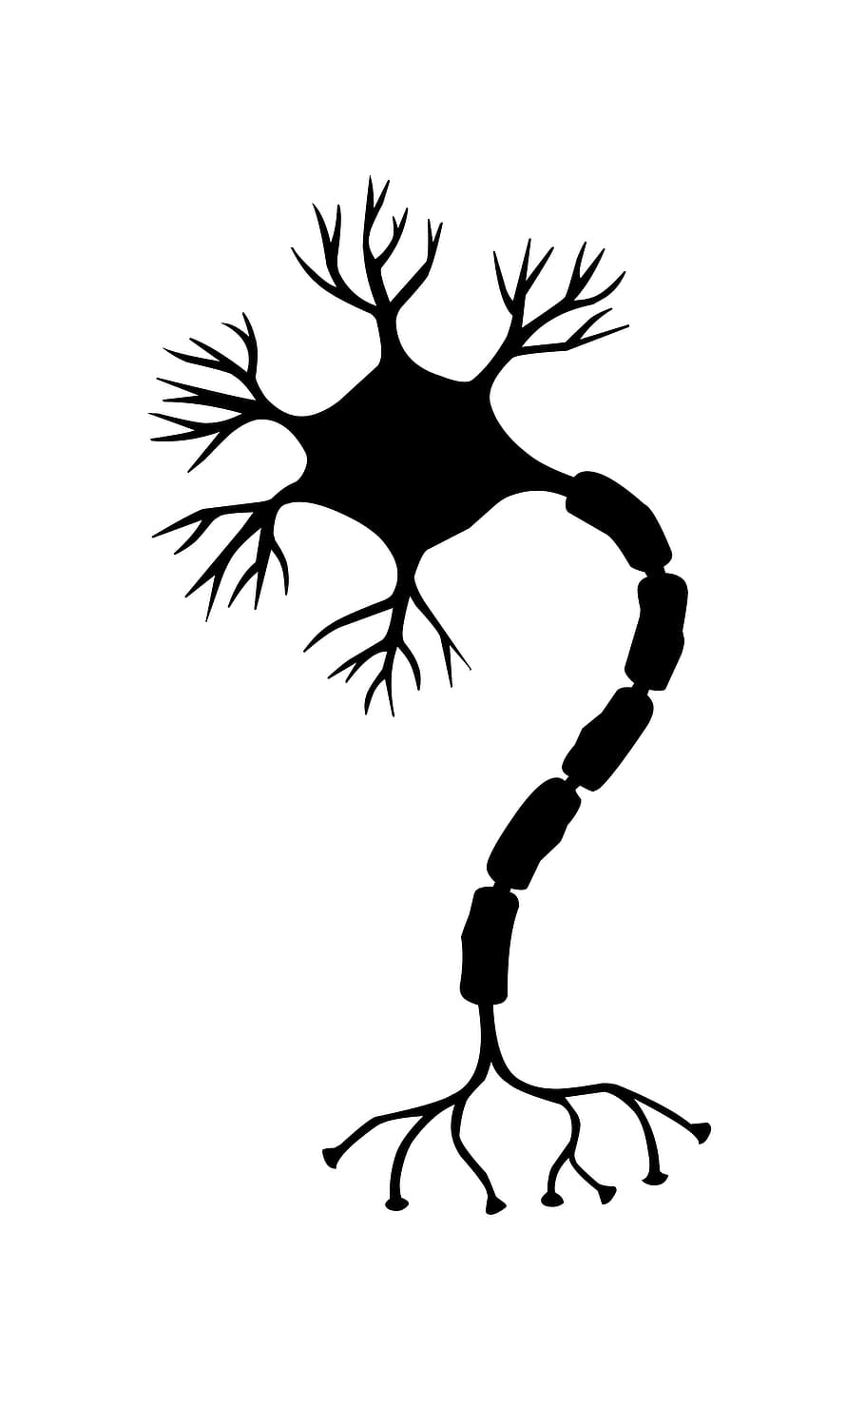
What are neural networks?
dendrites
axon
cell body
Neuron
Another neuron
axon
Neurons are cells that are part of the nervous system (brain, spinal cord, sensory organs, and nerves). They are often depicted as a core cell with many connections (axons/tendons) to other neurons.
The neurons thus form a neural network.
Some neurons respond to external signals, e.g. light or sound
Some neurons control muscle cells
Other neurons respond to signals from other neurons. Once they are agitated by other signals, they will ‘fire’ and send a signal to other neurons
axon terminals
Symbolic illustration of actual neuron
Illustration credit: Cenira Costa

Slide 9

Artificial neural networks
Input
Output
The following simple network can be used for making tiny robots that either move towards or away from the light.
Each neuron has an ‘activation’ (0, 1 or any value in between)
Each link has a ‘weight’, typically between -1.0 and 1.0
right sensor
0.99
right track
0.45
middle sensor
0.46
left track
0.98
left sensor

Slide 10

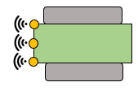
Artificial neural networks - example
Input
Output
If there is a light on the right side of the robot, the left track gets the strongest signal.
The robot will turn to the right, so towards the light.
For each neuron, you add up the sum of the input-neurons * weight
If the sum is above the threshold (e.g. 1), the neuron is activated
Input Activation (left track) =
1.0 * 0.99. + 0.2 * 0.46 =
0.99 + 0.09 = 1.08
right sensor
1.0
0.99
0.16
right track
0.2
0.45
middle sensor
0.46
1.08
left track
0.1
0.98
left sensor

Slide 11
Artificial neural networks – image classification
Input layer – 20 neurons
Middle layer – x neurons
Output layer – 10 neurons
1 | 2 | 3 | 4
5 | 6 | 7 | 8
9 | 10 | 11 | 12
13 | 14 | 15 | 16
17 | 18 | 19 | 20
“one”
“two”
“three”
Lack of signal, or negative signal
Positive signals
“nine”
“zero”
Notes:
Middle layers uitleggen

Slide 12
Training steps
Each neural network has inputs and outputs that are determined by the problem to solve.
The researcher decides on the number of neurons and number of ‘hidden’ layers. More complex problems require more layers, or larger layers.
The weights are determined through ‘machine learning’. Using large amounts of example data, the computer determines a good set of weights.
The researcher must check the quality of the network at the end. Training algorithms are not guaranteed to work.

Slide 13
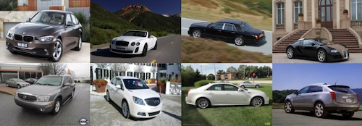
How to train? Step 1: data collection
Select a domain and problem statement.
Collect a lot of data. We use a published training set with car photos.
Annotate each photo. You need, for training purposes, the correct answers to any questions you want to ask.
What questions could we ask for a car photo data set?
Source: https://ai.stanford.edu/~jkrause/cars/car_dataset.html

Slide 14
Possible questions
Question | ML-task | How hard is it for humans?
Is there a car in the picture? | Detection | Easy
Which side of the car is visible? | Classification | Easy
What is the color of the car? | Classification | Easy
What is the brand of the car? | Classification | Medium
What body style (minivan, coupe, sedan, convertible) does the car have? | Classification | Medium
What is the value of the car? | Prediction/ estimation | Hard
What is the build year of the car? | Prediction/ estimation | Hard/Impossible
Do two pictures show the same car? | Identification | Hard/Impossible
Notes:
Lighting maakt laatste punt ook moeilijk

Slide 15
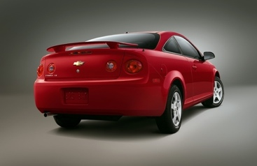
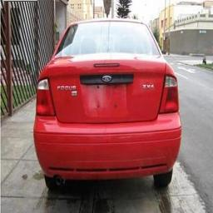
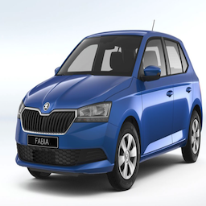
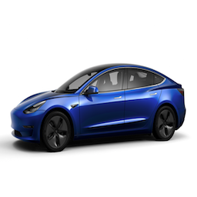
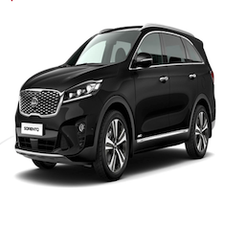
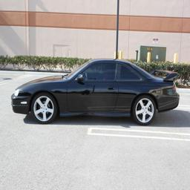
Example question 1: Car color
For this task we need pictures of cars in different colors. We sort these images by color in different folders.
The images must have a standard size, for example 256x256 pixels. You can resize the photos by hand or have your program do it for you.
The required output of the neural network is an indication how likely the car is ‘red’, ‘blue’ or any color we will train.
Red
Blue
Black

Slide 16
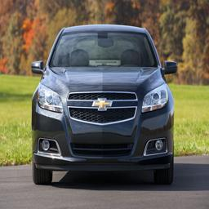
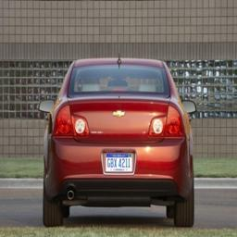
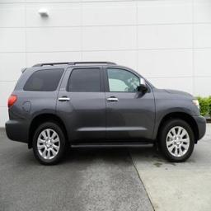
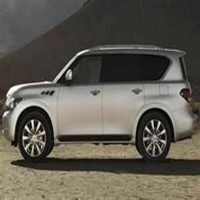
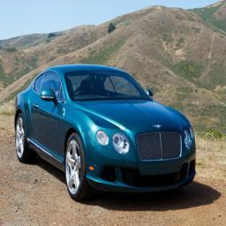

Example question 2: car rotation
CLASS_NAMES = [”Front", "Back", "Right", "Left", "Front right", "Front Left” ]
In this webinar, we will use another property cars in pictures have: rotation.
We sort these photos by angle in different folders.
We wrote some code to resize all images to 256x256 pixels.
The neural network will have six output neurons: one output neuron per angle.

Slide 17
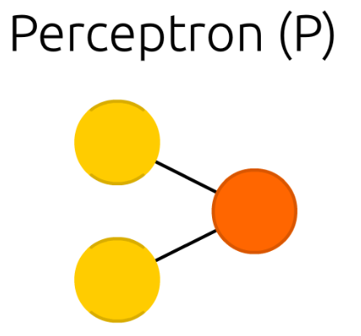
Simple topology – perceptron
A perceptron has no hidden layers. The output neuron(s) is/are a linear combination of the input neurons.
Training perceptrons is really fast.
Many problems are not trainable for perceptrons.
Source: Neural Network Zoo – Asimov Institute

Slide 18
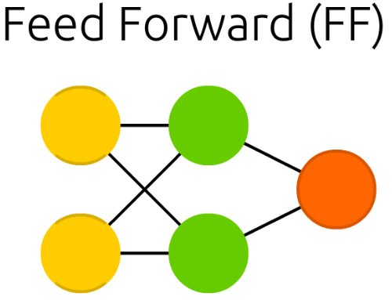
Feed Forward neural network
A feed forward network only has connections from left to right. This makes it easier to develop training algorithms.
You present the input on the left and get predictions/classifications on the right
These algorithms can act as a black box. If there are enough hidden neurons, it can be hard to explain how a decision was made.
Today we will use feed forward networks.
Source: Neural Network Zoo – Asimov Institute

Slide 19
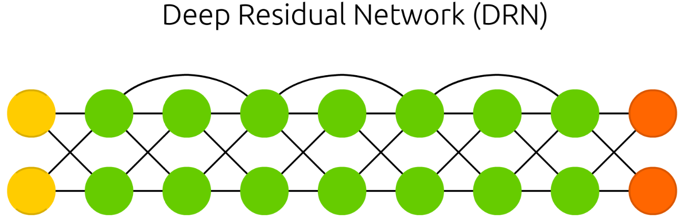
‘Deep’ networks
‘Deep’ networks have many hidden layers. They can learn more subtle, complex models
Networks with fewer hidden layers (1 or 2) are easier to train than more complex models. They are good for simpler tasks
Source: Neural Network Zoo – Asimov Institute

Slide 20
Model 1: simple feed forward
dense_model = keras.Sequential([
keras.layers.Flatten(input_shape=(IMG_PIX, IMG_PIX, 3), name='flatten'),
keras.layers.Dense(64, activation='relu', name='fc1'),
keras.layers.Dense(6, name='fc2'),
])
probability_model = keras.Sequential([dense_model, tf.keras.layers.Softmax()])
Layer | Input layer | Flatten | FC Dense layer 1 | FC Dense layer 2 | Output layer (Softmax)
Dimension: | 256x256x3 | 196608x1 | 64x1 | 6x1 | 6x1
Neurons: | 196608 | 196608 | 64 | 6 | 6
…
…
…
…
…

Slide 21
Dataset 1: Training and testing
All images
Training images
Test images
336 images
Notes:
Dataset laten zien

Slide 22
Training and test data
The algorithm is trained using the training data.
Typically, you train until most are classified correctly.
Some training algorithms separate the training data into training and ‘test’ data for testing during training
Training images
270 images
The algorithm is tested on the remaining test set, consisting of images that the algorithm has never seen before.
The performance on these new images is often lower, since these images might contain new challenges.
Test images
66 images

Slide 23
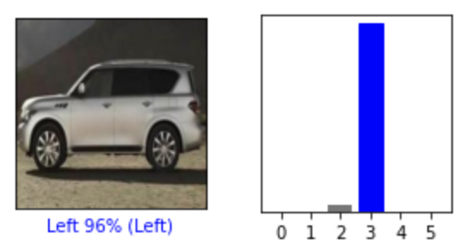
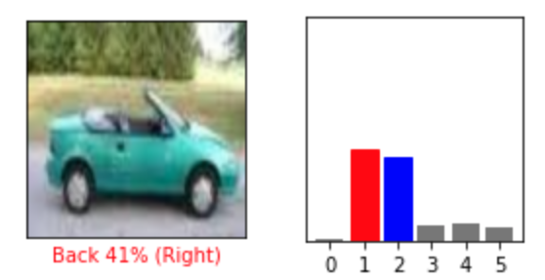
Example algorithm results
One neuron is 96% activated. It is neuron 3, aka ‘Left’
According to our label, this car is indeed facing left
CORRECT RESULT
No neuron has a more than 50% activation
Two neurons have a 40%+ activation: ‘back’ and ‘right’. The highest activation is ‘back’
According to our label, this car is facing right
INCORRECT RESULT
By checking the neural network values for all training and all test images, you can compute the accuracy (percentage of correct answers) for both the training set and the test set.

Slide 24
Quiz 1
What percentage accuracy do you expect on the training data?
What percentage accuracy do you expect on the test data?
Which categories will be confused most often?
Let’s find out in the first demo!

Slide 25
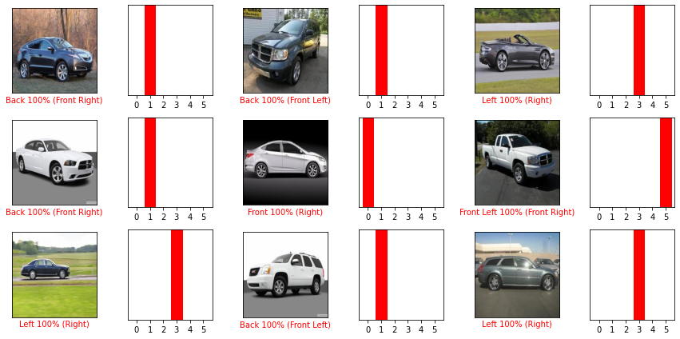
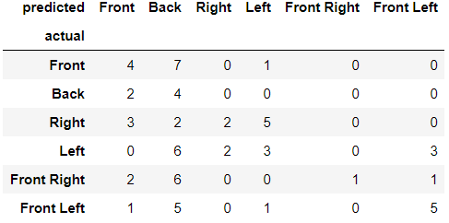
Quiz 1 answers (simple model, small dataset)
M1
D1
61% accuracy on the training set (decent)
29% accuracy on the test set (very poor)
Nearly all categories are confused.

Slide 26
Common problems during training
Symptom | Possible root cause | Next step
Low accuracy on training set, low accuracy on test set | Not enough training | Increase the number of training rounds
Persistent low accuracy on training set, low accuracy on test set | The network topology is too simple to learn this concept, or we have bad data | Change the topology by adding more layers, or clean up the data
High accuracy on training set, low accuracy on test set | ‘Overfitting’: the network has learning to recognize the training set | Simplify the topology, or add more data.
Training time too long, training accuracy does not converge | The network topology is too complex to learn this concept | Simplify the topology
High accuracy on training set, high accuracy on test set | It works! | Stop and save the trained network
Low accuracy on training set, high accuracy on test set | This is not possible. | Manually inspect your code and data

Slide 27

Model 2: Convolutional neural network
We chose this model based on recommendations in the literature. Apparently these first layers are good for learning similar visual concepts in different locations.
Notes:
https://medium.com/@RaghavPrabhu/understanding-of-convolutional-neural-network-cnn-deep-learning-99760835f148

Slide 28
Model 2: Convolutional neural network
cv_model = keras.Sequential([
keras.layers.Conv2D(32, (3, 3), activation='relu', input_shape=(IMG_PIX, IMG_PIX, 3), name='block1_conv1'),
keras.layers.MaxPooling2D((2, 2), name='block1_maxpool'),
keras.layers.Conv2D(64, (3, 3), activation='relu', name='block2_conv1'),
keras.layers.MaxPooling2D((2, 2), name='block2_maxpool'),
keras.layers.Conv2D(32, (3, 3), activation='relu', name='block3_pool'),
keras.layers.Flatten(name='flatten_6'),
keras.layers.Dense(64, activation='relu', name='fc1'),
keras.layers.Dense(6, name='fc2'),
])
probability_model = tf.keras.Sequential([cv_model, tf.keras.layers.Softmax(name='softmax_9')])
Layer | Input layer | Conv. 1 | Pool 1 | Conv. 2 | Pool 2 | Conv. 3 | Flatten | Dense 1 | Dense 2 | Output (Softmax)
Dimension: | 256x256x3 | 254x254x32 | 127x127x32 | 125x125x64 | 62x62x64 | 60x60x32 | 115200x1 | 64x1 | 6x1 | 6x1
Neurons: | 196608 | 2064512 | 1032256 | 1000000 | 246016 | 115200 | 115200 | 64 | 6 | 6
…
…
…
…
…
…
…
…
…
…

Slide 29
Quiz 2
What percentage accuracy do you expect on the training data?
What percentage accuracy do you expect on the test data?
Which categories will be confused most often?
Let’s find out in the second demo!

Slide 30
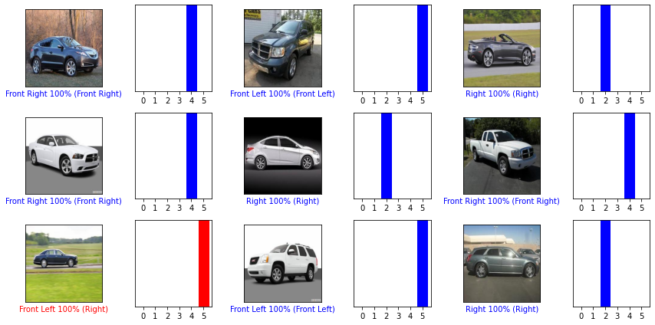
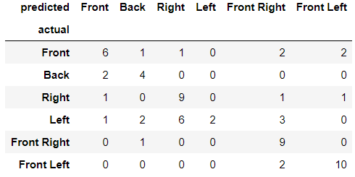
Quiz 2 answers (complex model, small dataset)
M2
94% accuracy on the training set (very good)
61% accuracy on the test set (decent)
Front and Back are often confused
D1

Slide 31
Common problems during training
Symptom | Possible root cause | Next step
Low accuracy on training set, low accuracy on test set | Not enough training | Increase the number of training rounds
Persistent low accuracy on training set, low accuracy on test set | The network topology is too simple to learn this concept, or we have bad data | Change the topology by adding more layers, or clean up the data
High accuracy on training set, low accuracy on test set | ‘Overfitting’: the network has learning to recognize the training set | Simplify the topology, or add more data.
Training time too long, training accuracy does not converge | The network topology is too complex to learn this concept | Simplify the topology
High accuracy on training set, high accuracy on test set | It works! | Stop and save the trained network
Low accuracy on training set, high accuracy on test set | This is not possible. | Manually inspect your code and data

Slide 32

Getting more data: 3 options
The ’honorable’ way is to get out there and make new pictures. This is however costly and time consuming
A poor way of getting data is to search for existing large data sets with data similar to what is needed. A major challenge is that you often have to manually add the property you want to train according to your classification
Technical trickery: using fabricated data that may or may not trick your algorithm. We would never do this, except when it is really convenient.
Src: andrew-draper via unsplash

Slide 33
Model number 2 + more data
Our neural network is quite large because we have many input neurons.
We therefore expect that more data will do more for the performance than an even more advanced model.
This is just a hunch: in practice, the search for better data and better model go hand in hand.
M2
M2
D2
Advanced model
D1
Simple model
M1
D1
Small dataset
Large dataset

Slide 34
Quiz 3
What percentage accuracy do you expect on the training data?
What percentage accuracy do you expect on the test data?
Which categories will be confused most often?
M2
D2
M2
instead of
D1

Slide 35
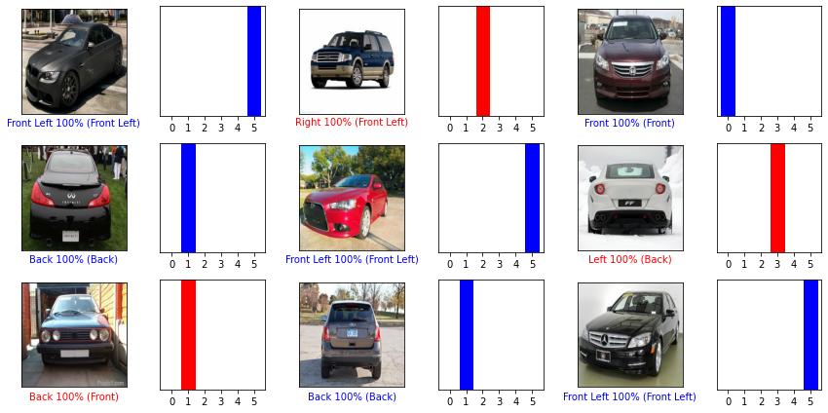
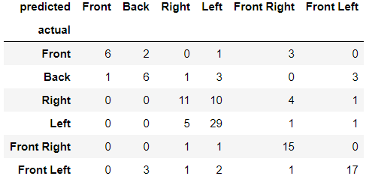
Quiz 3 answers (complex model, large data)
M2
D2
99% accuracy on the training set (excellent)
65% accuracy on the test set (poor)
Front is not predicted well, right and left often confused

Slide 36
Common problems during training
Symptom | Possible root cause | Next step
Low accuracy on training set, low accuracy on test set | Not enough training | Increase the number of training rounds
Persistent low accuracy on training set, low accuracy on test set | The network topology is too simple to learn this concept, or we have bad data | Change the topology by adding more layers, or clean up the data
High accuracy on training set, low accuracy on test set | ‘Overfitting’: the network has learning to recognize the training set | Simplify the topology, or add more data.
Training time too long, training accuracy does not converge | The network topology is too complex to learn this concept | Simplify the topology
High accuracy on training set, high accuracy on test set | It works! | Stop and save the trained network
Low accuracy on training set, high accuracy on test set | This is not possible. | Manually inspect your code and data

Slide 37
Final step: technical trickery
Technical trickery is not a silver bullet. By expanding existing data, you could be expanding existing bias. It can lead to an illusion of accuracy, especially when you confuse training and test accuracy.
Having said that, in some cases algorithms (and people) learn better from seeing related examples

Slide 38
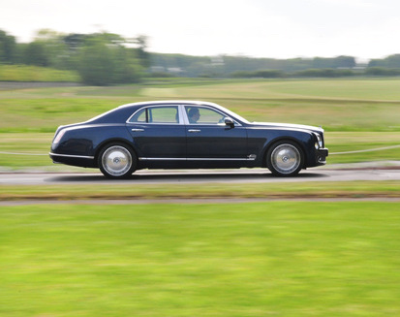
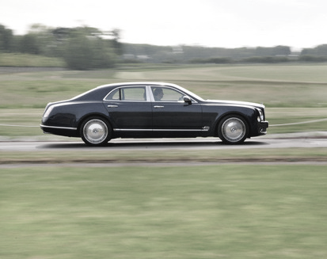
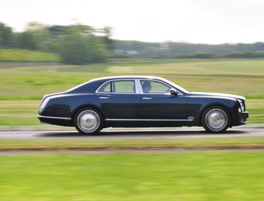
How we expand the data
Original
The right and left sides of cars are not truly identical, but very similar and would trick 99% of people
08562f.jpg (‘left’)
Color removed. This teaches the algorithm we do not care about color
08562c.jpg (‘right’)
Small translation or rotation. This teaches the algorithm we do not care too much about positions
08562.jpg (‘right’)
All four images are included in the training set. The test set will only have original images
08562p.jpg (‘left’)

Slide 39
Quiz 4
What percentage accuracy do you expect on the training data?
What percentage accuracy do you expect on the test data?
Which categories will be confused most often?
M2
D2 expanded
M2
D2
instead of

Slide 40
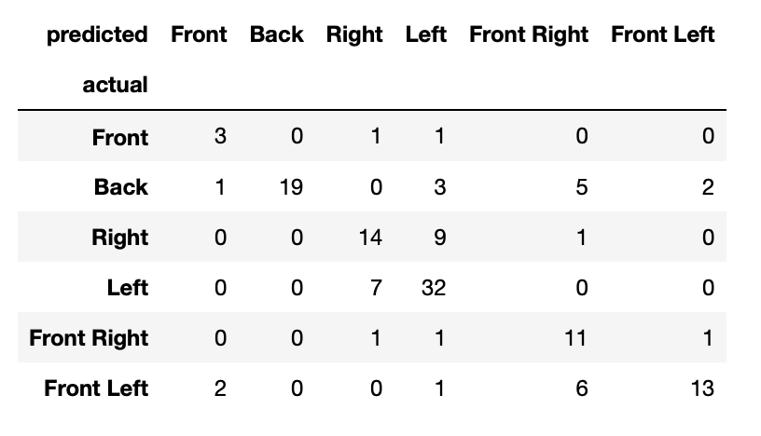
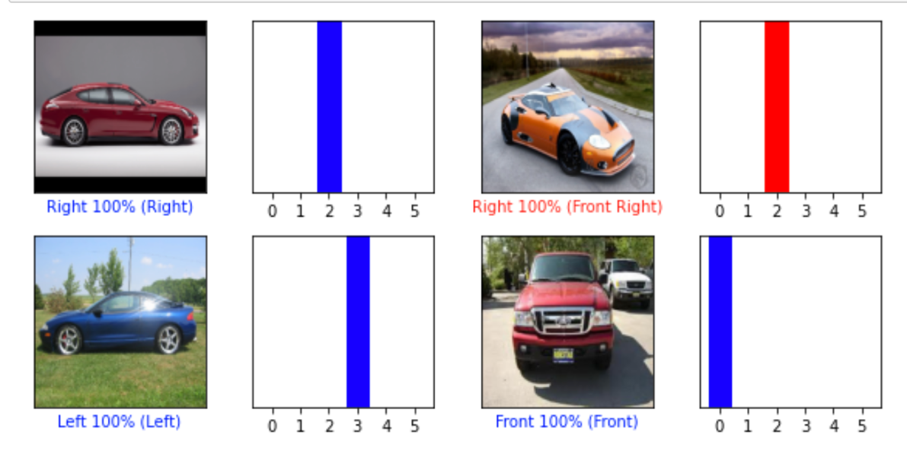
Results
M2
D2 expanded
65% accuracy on the training set
71% accuracy on the test set
Left and right most often confused

Slide 41
Conclusion
Improve topology
Select data
Train
Test
Compare results
Training neural networks is an iterative process, that requires human judgment and experiment
The best algorithm will not work if you do not have enough data
Algorithms must be independently verified. Accuracy number on training data are often way too optimistic

Slide 42
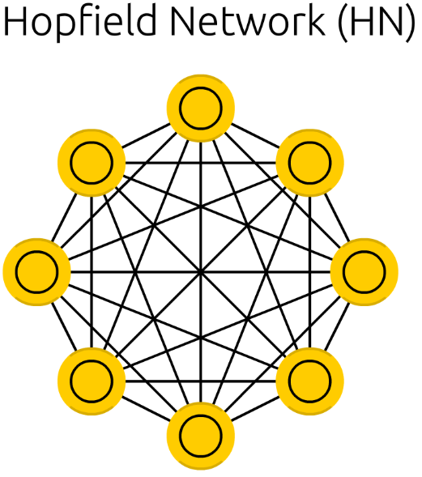
Hopfield network
In the Hopfield network, every neuron is an input neuron.
Each neurons learns which of their neighbours often have a similar activation. If so, their connection is strengthened.
You can use the network to complete partial data (e.g. in character recognition). The network can will try to reconstruct a learned state from new input.
These more complex topologies are more similar to real brain cells, but harder to use for prediction.
Source: Neural Network Zoo – Asimov Institute

Slide 43
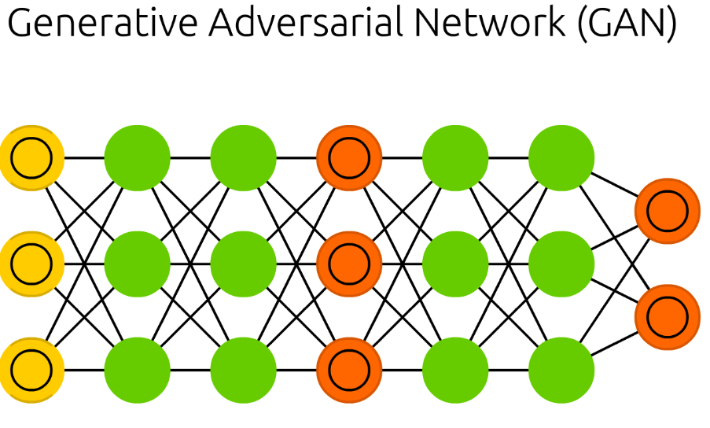
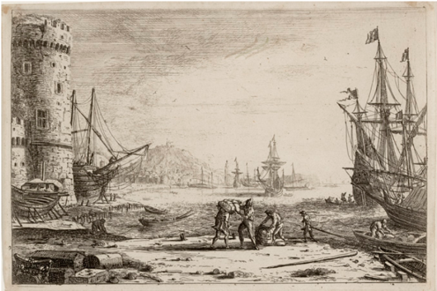
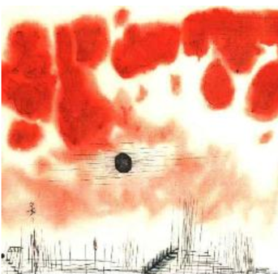
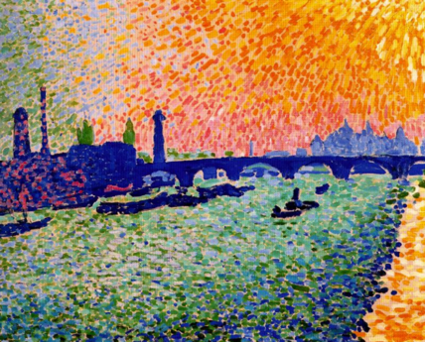
Other uses
GANs can be used to generate new images from existing images.
One example is style transfer: how would an image look in a different art style?
Another example is deep fakes: generate photos and videos that look real but are fictional
Input image
new image
Target function

Slide 44

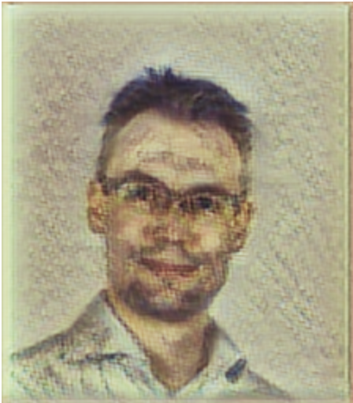
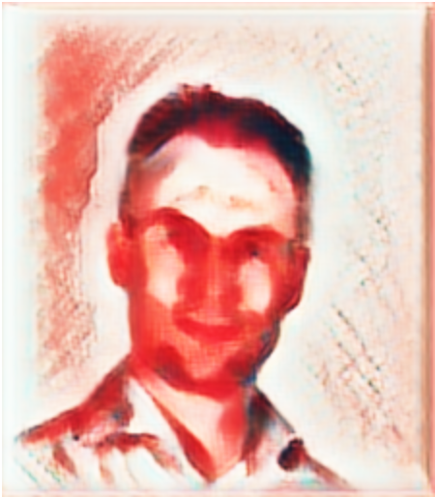
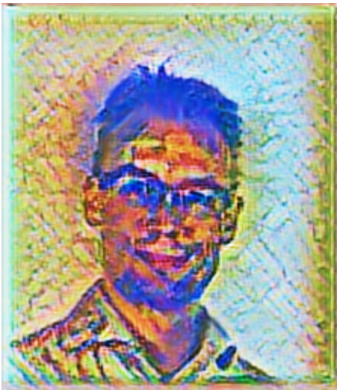
Neural network Style transfer
=
=
=
Generated by:
https://reiinakano.com/arbitrary-image-stylization-tfjs/

Slide 45
Agenda
Explanation of machine learning and neural networks
Training a machine learning algorithm (Demonstration)
Practical and ethical consequences of using machine learning

Slide 46
Problem: Neural networks are not perfect
Solution: Monitoring and evaluation
Many neural networks receive less than perfect scores
Even if the average score is fine, it can do poorly an individual cases
The result of tested neural networks can go down
One should monitor automated decision making by checking the decisions
Data sets should be regularly expanded with new cases

Slide 47
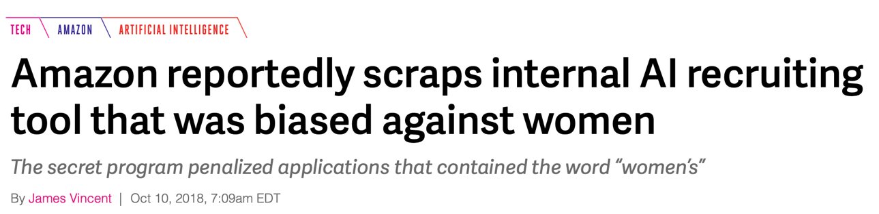
Problem: Neural networks propagate bias
Solution: Accurate data annotation
Make sure that input data is correctly annotated
Hire experts to validate data sets, especially if you cannot validate the annotation yourself
Many data sets have implicit bias from human decision making
Neural networks will learn any mistakes in the data set

Slide 48
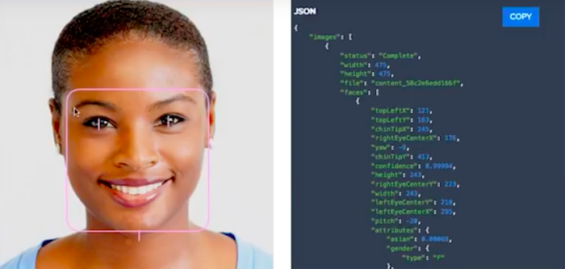
Problem: Algorithmic bias
Solution: responsible use of AI measures
Carefully phrase detailed quality criteria.
Make sure training sets are diverse and unbiased.
Test the resulting system on a diverse group of subjects, both in lab and in the field.
Do not implement automated decision making without human safeguarding. This is not just sound advice, this is a legal requirement under EU privacy law
Provide transparency on algorithms and test data. People have a right to know how decisions are made
Ask consent for use of AI and provide a mechanism for questions and complaints.
Most data scientists are rich-country, young, abled, white, male people with interest in computer science
Algorithms and datasets are over-tested on people with the same characteristics, often in good circumstances (high-def camera’s, perfect lighting)
Algorithms are often used in completely different circumstances
https://ictinstitute.nl/algorithmic-bias-project-management/

Slide 49
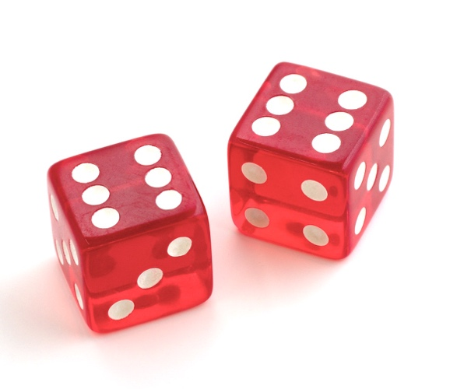
Problem: repeatability
Solution?
Educate decision makers on AI. Involve them in the training and testing process.
Ask questions when AI is mentioned, such as:
How was data obtained?
How was data annotated?
How often is the algorithm updated, recalibrated or retested?
Is there a human in the loop? What percentage of decisions are checked?
Are people affected by decision informed about the data used?
The names ‘machine learning’ and ‘data science’ might lead one to believe that there is a set procedure that guarantees a correct result. This is not the case
A lot of AI and machine learning applications are based on trial and error using insufficient and imperfect data.

Slide 50

Problem: explainability
Solution?
Not using neural networks?
Publishing all data and the training algorithm?
Re-assessment by human expert?
Some research is being done to add explainability rules to neural networks.
Neural network decisions are often hard to explain. It is not clear what rules or what inputs are used to come to certain decisions.
Neural network decisions may seem random, and could have been different in case of retraining

Slide 51
Conclusion
Neural networks can be trained for many different tasks. You can do this yourself using python and a lot of patience.
Neural networks are only as good as their input data and training process. The results are often ‘interesting’ but they do require supervision
Algorithms do not just ‘steal jobs’ but also create many new jobs, such as testing, supervision and annotation.

